Slide 1
Models of the motor system
Fall 2021
Opher Donchin

Slide 2
Part 1
Reminder reward learning

Slide 3
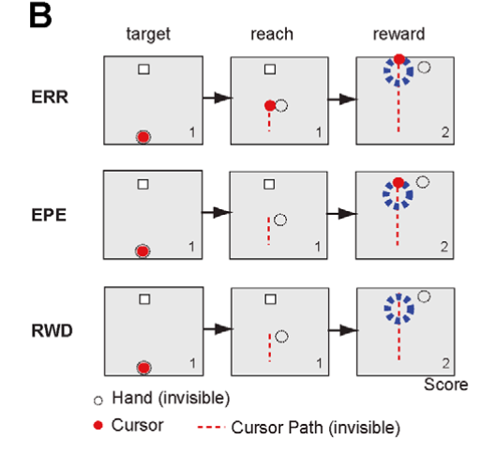
Teaching with errors and rewards
Error feedback
Endpoint feedback
Reward feedback
Izawa PLOS Computational Biology 2011 doi:10.1371/journal.pcbi.1002012

Slide 4
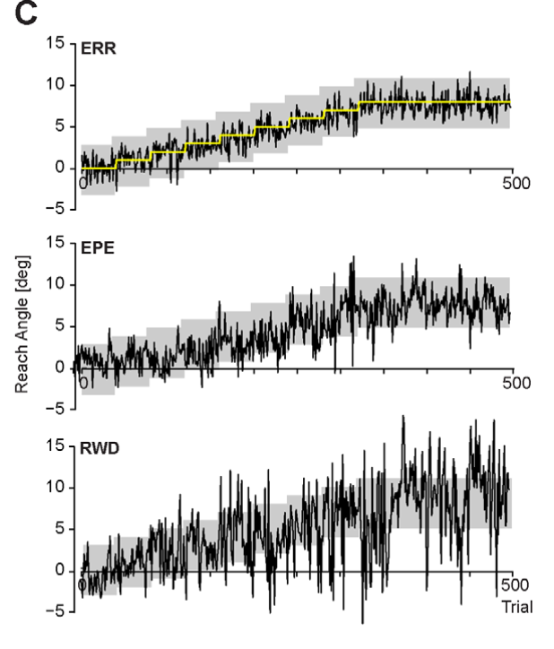
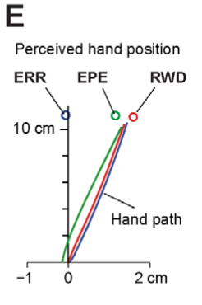
Learning from errors and rewards
Izawa PLOS Computational Biology 2011 doi:10.1371/journal.pcbi.1002012

Slide 5
Model the movements
Hand and cursor
Internal estimates
Vectorization
Izawa PLOS Computational Biology 2011 doi:10.1371/journal.pcbi.1002012

Slide 6
Kalman filter as error based learning
Kalman filter
State equations
Kalman gain
Izawa PLOS Computational Biology 2011 doi:10.1371/journal.pcbi.1002012

Slide 7
State variance
State equations
Variance propagation
Kalman filter
Izawa PLOS Computational Biology 2011 doi:10.1371/journal.pcbi.1002012

Slide 8
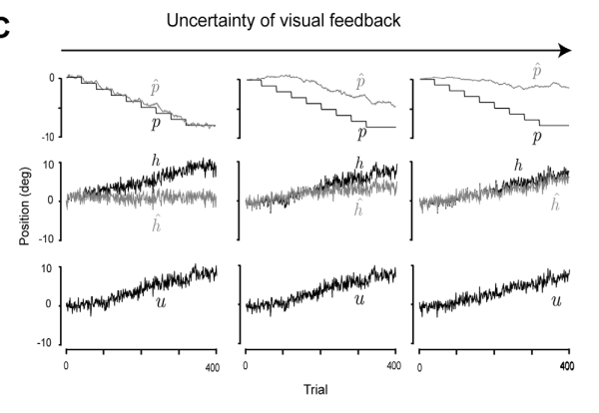
Credit assignment problem
Izawa PLOS Computational Biology 2011 doi:10.1371/journal.pcbi.1002012

Slide 9
Deciding on the movement
Control policy
State equations
Kalman filter
Variance propagation
Izawa PLOS Computational Biology 2011 doi:10.1371/journal.pcbi.1002012

Slide 10
Reward based learning
State equations
Policy learning
Kalman filter
Control policy
Reward learning
Izawa PLOS Computational Biology 2011 doi:10.1371/journal.pcbi.1002012

Slide 11
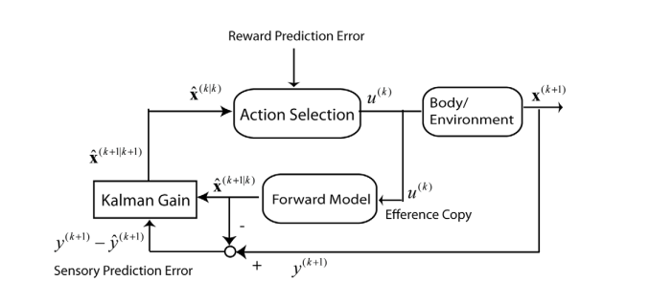
Box and arrow diagram of the model
Izawa PLOS Computational Biology 2011 doi:10.1371/journal.pcbi.1002012

Slide 12
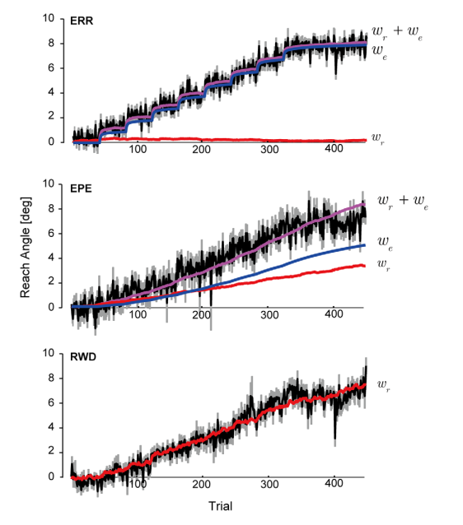
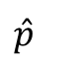
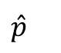
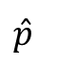
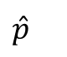
Model successfully learns from error or reward
$$\hat{p}$$
$$\hat{p}$$
$$\hat{p}$$
$$\hat{p}$$
Izawa PLOS Computational Biology 2011 doi:10.1371/journal.pcbi.1002012

Slide 13
Part 2
Reinforcement and explicit learning

Slide 14
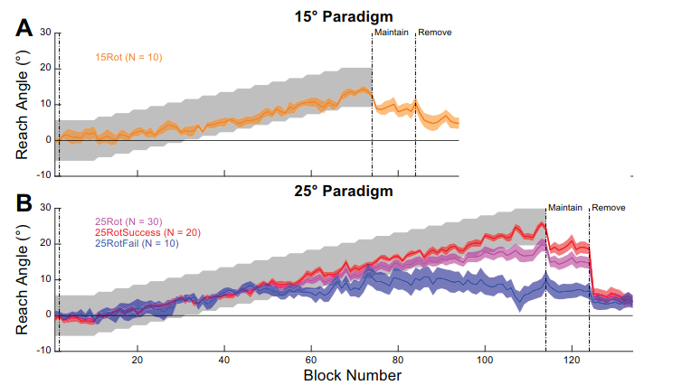
Reinforcement learning can be “turned off”
Holland J Neurophysiol 2018 doi:10.1152/jn.00901.2017

Slide 15
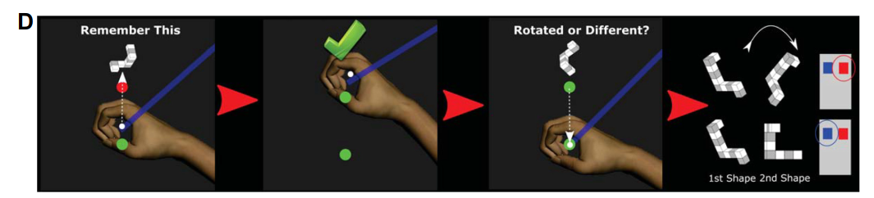
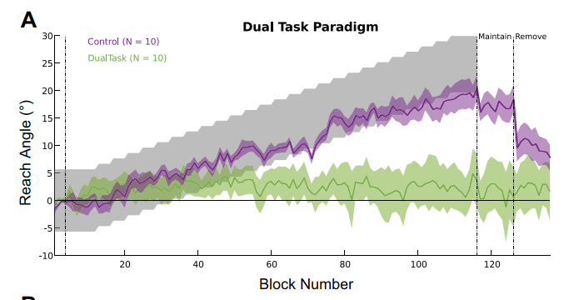
Dual task wipes out reinforcement learning
Holland J Neurophysiol 2018 doi:10.1152/jn.00901.2017

Slide 16
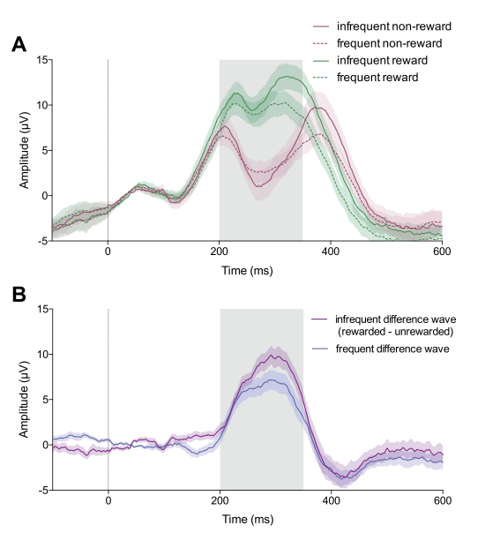
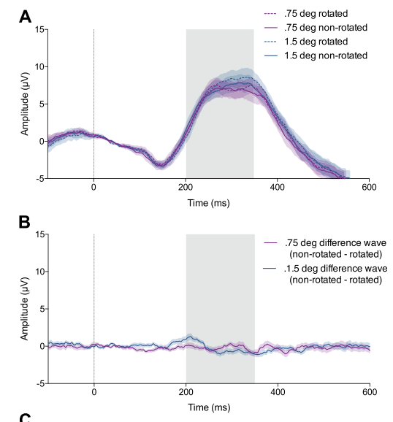
Different EEG for reward and error based learning
Reward based
Error based
Palidis J Neurophysiol 2019 doi:10.1152/jn.00792.2018

Slide 17
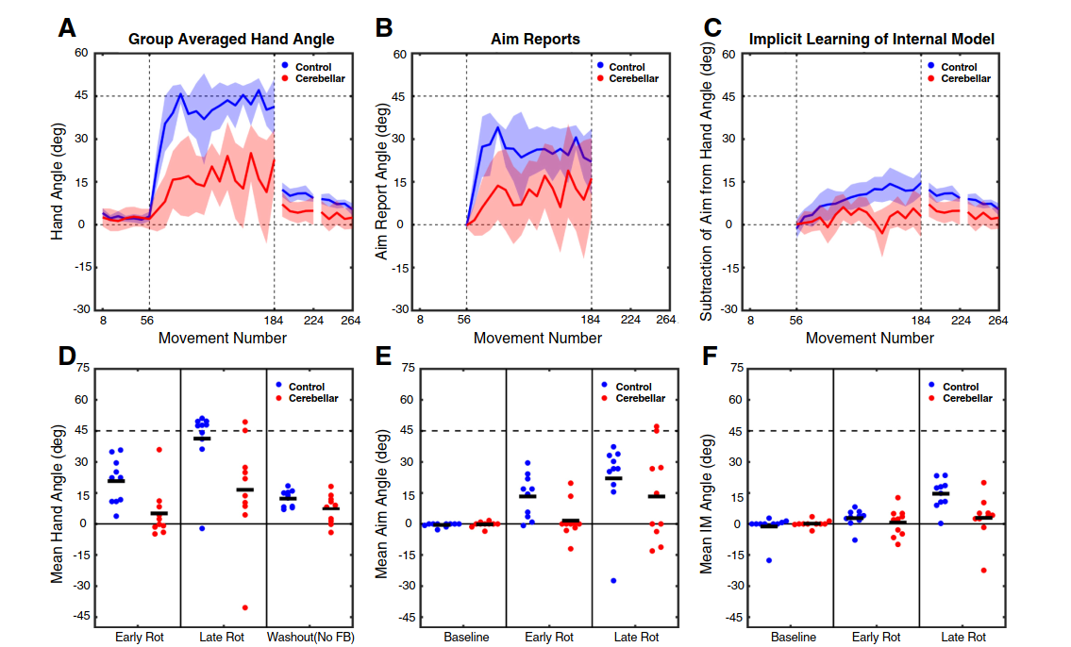
But cerebellar patients have poor explicit AND implicit
Butcher J Neurophysiol 2017 doi:10.1152/jn.00451.2017

Slide 18
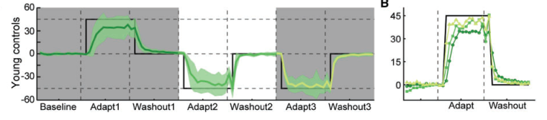
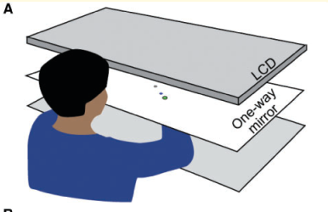
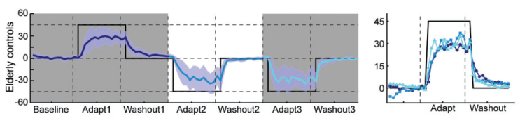
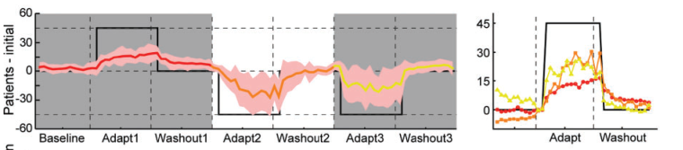
Can be rescued by “providing” explicit strategy
Wong J Brain 2019 doi:10.1093/brain/awz020

Slide 19
Part 3
Exploration and noise

Slide 20
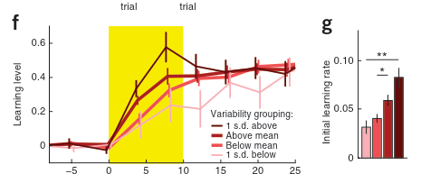
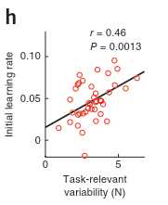
Variability is correlated to learning
Wu et al, Nature Neuroscience, 2014

Slide 21
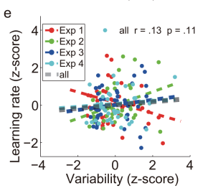
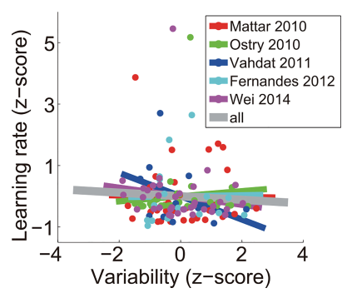
But not in all experiments
He et al, PLOS Computational Biology, 2016

Slide 22
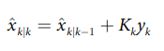
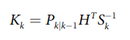
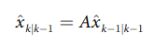
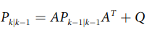
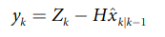
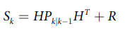
Explanation: different types of noise
Learning
Learning rate
Forgetting
Planning noise
Behavior
Execution noise
Kalman filter models predict learning will be:
Correlated with planning noise
Inversely correlated with execution nosie
He et al, PLOS Computational Biology, 2016

Slide 23
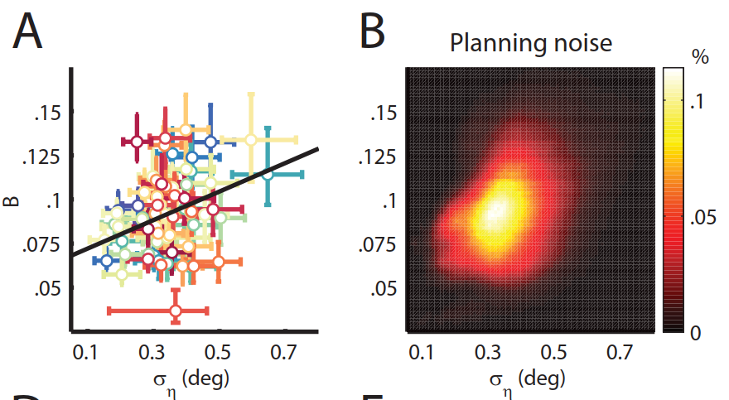
Planning noise correlated with learning
Van Der Vliet eNeuro 2018 doi:10.1523/ENEURO.0170-18.2018

Slide 24
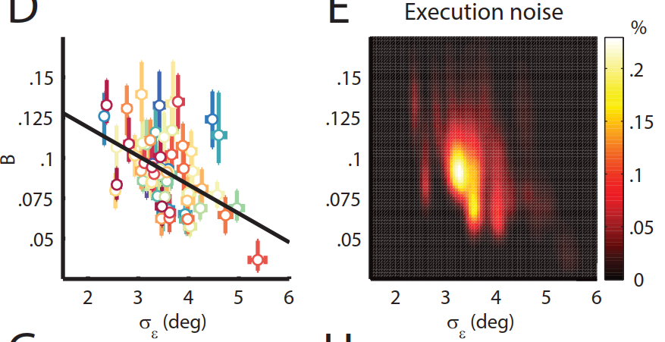
Execution noise inversely correlated
Van Der Vliet eNeuro 2018 doi:10.1523/ENEURO.0170-18.2018

Slide 25
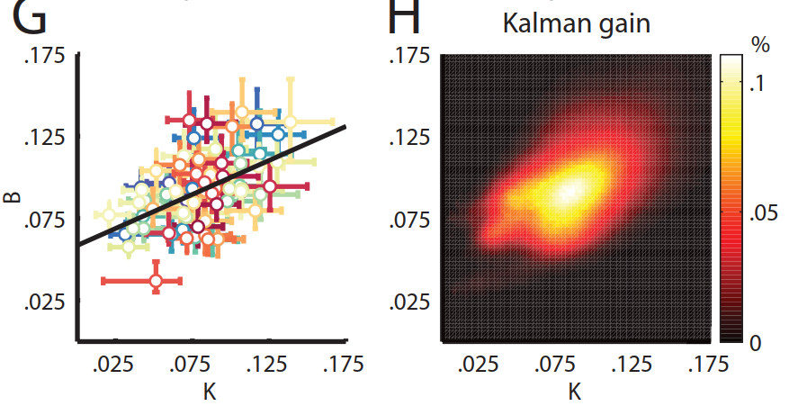
Optimal Kalman gain predicts learning
Van Der Vliet eNeuro 2018 doi:10.1523/ENEURO.0170-18.2018

Slide 26
Error related negativity 400 ms latency
Jonker bioRxiv 2020 doi:10.1101/2020.07.12.188581

Slide 27
Noisier subjects learn slower
Noisy, slow learning subject
Non-noisy, fast learning subject
Jonker bioRxiv 2020 doi:10.1101/2020.07.12.188581

Slide 28
Less noisy subject has sensitivity to error
Non-noisy, fast learning subject
Noisy, slow learning subject
EEG highly sensitive to error
Jonker bioRxiv 2020 doi:10.1101/2020.07.12.188581

Slide 29
Noisier subject has no error sensitivity
Noisy, slow learning subject
Non-noisy, fast learning subject
EEG insensitive to error
EEG highly sensitive to error
Jonker bioRxiv 2020 doi:10.1101/2020.07.12.188581

Slide 30
Part 3
Noise, exploration and reinforcement learning

Slide 31
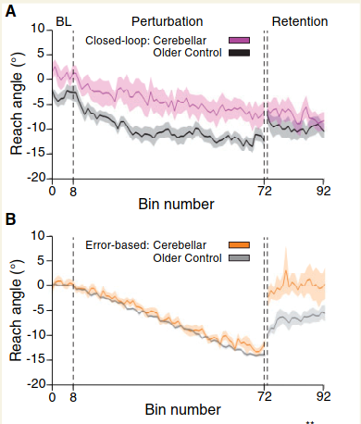
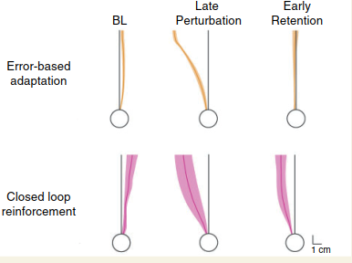
Cerebellar subjects forget error based learning
Therrien Brain 2016 doi:10.1093/brain/awv329

Slide 32
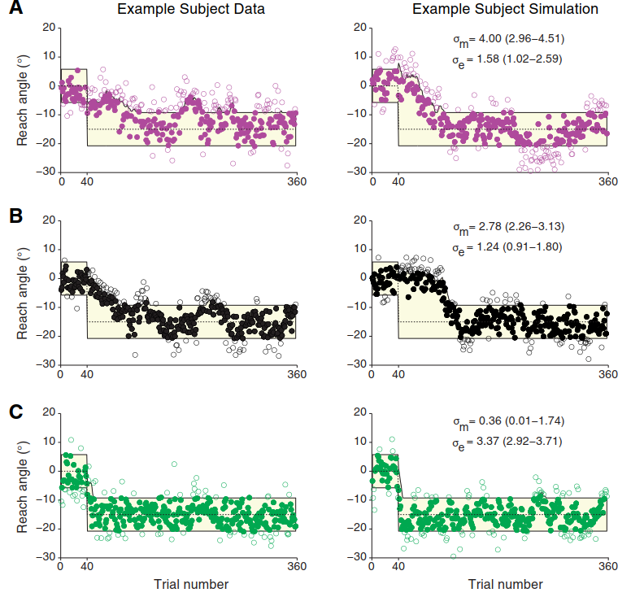
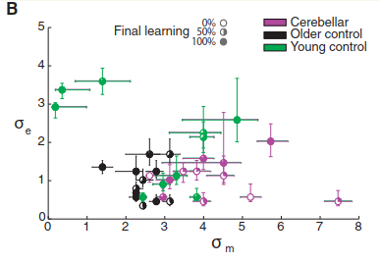
Cerebellar subjects: noise and reinforcement
Cerebellar
Older
Younger
Therrien Brain 2016 doi:10.1093/brain/awv329

Slide 33
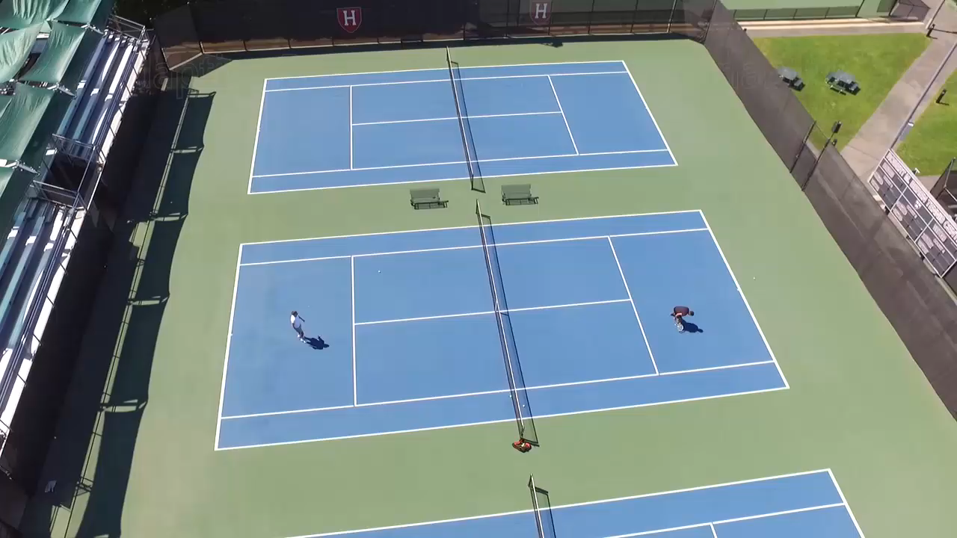
Reinforcement and variability
Link to video
Dhawale Curr Biol 2019 doi:10.1016/j.cub.2019.08.052

Slide 34
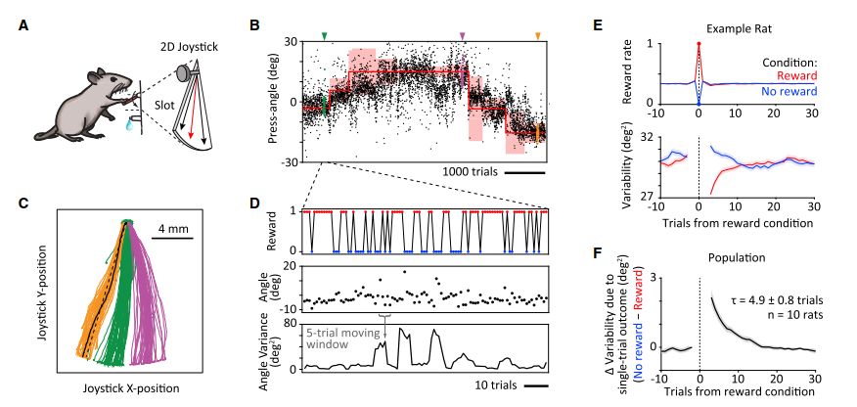
Reward drives changes in variability
Dhawale Curr Biol 2019 doi:10.1016/j.cub.2019.08.052

Slide 35
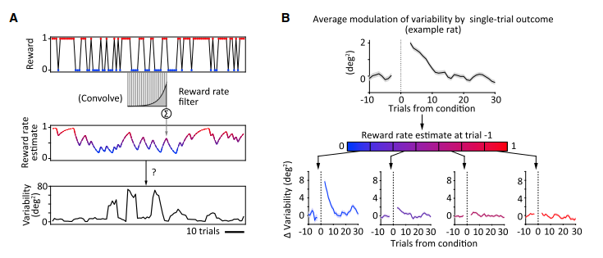
Reward rate reduces changes in variability
Dhawale Curr Biol 2019 doi:10.1016/j.cub.2019.08.052

Slide 36
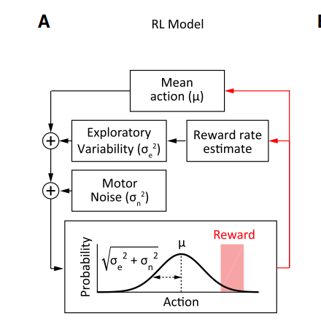
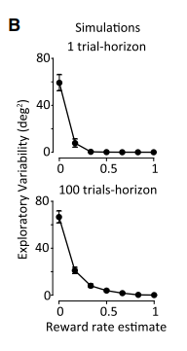
Making a model
Dhawale Curr Biol 2019 doi:10.1016/j.cub.2019.08.052

